Slide 1



AcF 304 Financial Markets
Topic 3: Bond Markets 2
Notes:
If this PowerPoint presentation contains mathematical equations, you may need to check that your computer has the following installed:
1) MathType Plugin
2) Math Player (free versions available)
3) NVDA Reader (free versions available)

Slide 2
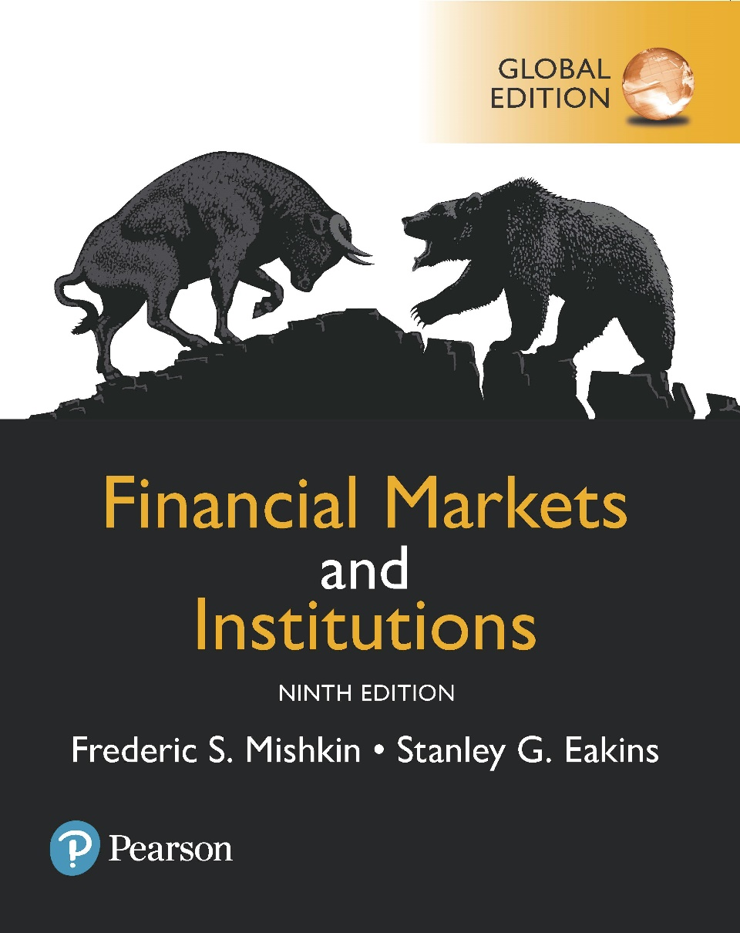
Financial Markets and Institutions
Ninth Edition, Global Edition
Reading – Chapter 12 The Bond Market
Notes:
If this PowerPoint presentation contains mathematical equations, you may need to check that your computer has the following installed:
1) MathType Plugin
2) Math Player (free versions available)
3) NVDA Reader (free versions available)

Slide 3
Chapter Preview
Purpose of the Capital Market
Capital Market Participants
Capital Market Trading
Types of Bonds
Treasury Notes and Bonds
Municipal Bonds
Corporate Bonds
Financial Guarantees for Bonds
Oversight of the Bond Markets
Current Yield Calculation
Finding the Value of Coupon Bonds
Investing in Bonds

Slide 4
Purpose of the Capital Market
Original maturity is greater than one year, typically for long-term financing or investments
Best known capital market securities:
Stocks and bonds

Slide 5
Capital Market Participants
Primary issuers of securities:
Federal and local governments: debt issuers
Corporations: equity and debt issuers
Largest purchasers of securities:
You and me

Slide 6
Capital Market Trading
Primary market for initial sale (I P O)
Secondary market
Over-the-counter
Organized exchanges (i.e., N Y S E)

Slide 7
Types of Bonds
Bonds are securities that represent debt owed by the issuer to the investor, and typically have specified payments on specific dates.
Types of bonds we will examine include long-term government bonds (T-bonds), municipal bonds, and corporate bonds.

Slide 8
Treasury Notes and Bonds
The U.S. Treasury issues notes and bonds to finance its operations.
The following table summarizes the maturity differences among the various Treasury securities.
Type | Maturity
Treasury bill | Less than 1 year
Treasury note | 1 to 10 years
Treasury bond | 10 to 30 years

Slide 9
Treasury Bond Interest Rates
No default risk since the Treasury can print money to payoff the debt
Very low interest rates, often considered the risk-free rate (although inflation risk is still present)

Slide 10
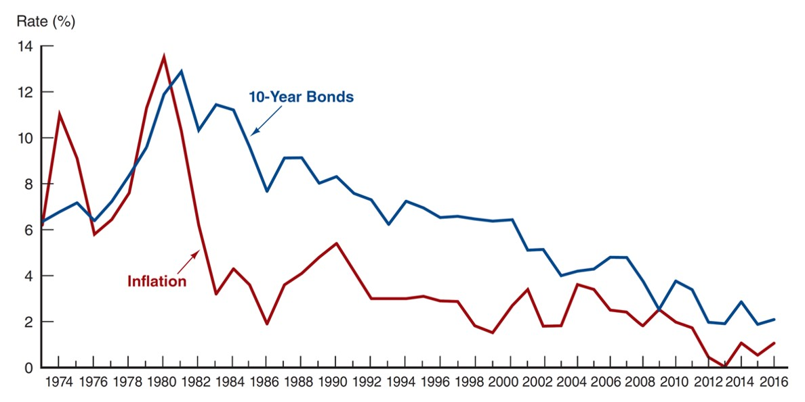
Interest Rate on Treasury Bonds and the Inflation Rate, 1973–2016 (January of Each Year)
Source:
http://www.federalreserve.gov/releases
and
https://www.treasury.gov/resource-
center/data-chart-center/interest-rates/Pages/TextView.aspx?data=reallongtermrate
.
Notes:
The vertical axis is labeled "Rate (Percent)" and ranges from 0 to 14 in increments of 2. The horizontal axis lists dates from 19 74 to 20 16 in 2-year increments. The line for inflation shows rate to be 6.2% for the year 19 74, which falls down to 5.8% by 19 76 but recovers back to a peak value of 14% by 19 80. The rate shows a sudden decline thereafter and falls down to 2% by 1986 but increases to 5.5% by 19 90. With a fluctuating trend over the years, the rate falls down to 1.75% by 2002 and becomes 0% in 20 13 and shows a slight gain in 20 14 to reach to a value of 1%. The line for 10-year bonds shows the rate close to 6.2% for the year 19 74, which increases to a peak value of 12.5% by the year 1981. The rate for this category shows a consistent decline over the years and falls down to a value of 6% by 19 93, 4% in 2006, and 2% in 20 12. It recovers back to 3% in 20 14 but falls down once again to 2% by 20 15. All values are approximate.

Slide 11
Treasury Bonds: Recent Innovation
Treasury Inflation-Indexed Securities: the principal amount is tied to the current rate of inflation to protect investor purchasing power
Treasury S T R I P S: the coupon and principal payments are “stripped” from a T-Bond and sold as individual zero-coupon bonds.

Slide 12
Treasury Bonds: Agency Debt
Although not technically Treasury securities, agency bonds are issued by government-sponsored entities, such as Student Loan Marketing Association (Sallie Mae).
The debt has an “implicit” guarantee that the U.S. government will not let the debt default. This “guarantee” was clear during the 2008 bailout.

Slide 13
Municipal Bonds
Issued by local, county, and state governments
Used to finance public interest projects

Slide 14
Municipal Bonds: Example
Suppose the rate on a corporate bond is 5% and the rate on a municipal bond is 3.5%. Which should you choose? Your marginal tax rate is 28%.

Slide 15
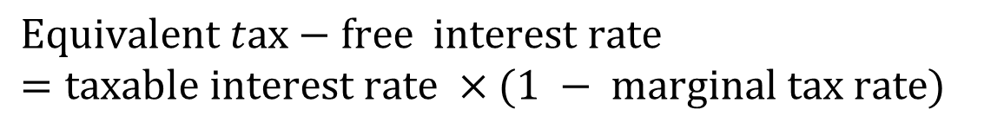
Municipal Bonds: Example
Suppose the rate on a corporate bond is 5% and the rate on a municipal bond is 3.5%. Which should you choose? Your marginal tax rate is 28%. Find the equivalent tax-free rate (E T F R):
$$Equivalent tax−free interest rate=taxable interest rate ×(1 − marginal tax rate)$$
$$\text{ETFR}=\text{5\%}×(1−\text{MTR})=\text{5\%}×(1−\text{0.28})$$
The E T F R = 3.36%. If the actual muni-rate is above this (it is), choose the muni.

Slide 16
Municipal Bonds
Two types
General obligation bonds
Revenue bonds
NOT default-free (e.g., Orange County California)
Defaults in 1990 amounted to $1.4 billion in this market

Slide 17
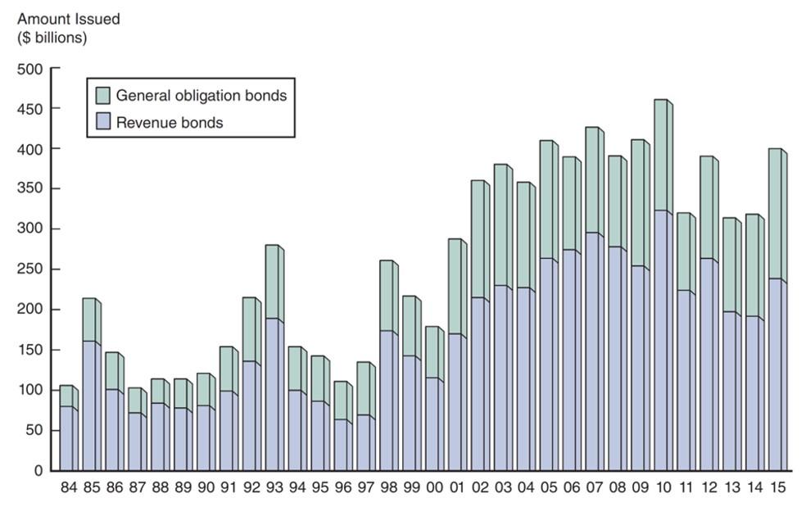
Issuance of Revenue and General Obligation Bonds, 1984–2015 (End of Year)
Source:
http://www.federalreserve.gov/econresdata/releases/govsecure/current.htm
.
Notes:
The vertical axis is labeled Amount Issued left parenthesis dollar billions right parenthesis and ranges from 0 to 500 in increments of 50. The horizontal axis lists dates from 19 84 to 20 15 in 1-year increments. The data shown by the graph is given in the following table. The values used are approximate. Year Amount Issued left parenthesis dollar billions right parenthesis Revenue bonds General obligation bonds 19 84 75 25 19 85 160 60 19 86 100 50 19 87 70 30 19 88 85 25 19 89 80 30 19 90 80 40 19 91 100 50 19 92 140 85 19 93 200 100 19 94 100 60 19 95 90 55 19 96 70 50 19 97 75 70 19 98 175 90 19 99 150 75 2000 125 70 2001 175 125 2002 225 150 2003 237.5 150 2004 237.5 137.5 2005 275 150 2006 300 150 2007 325 150 2008 310 125 2009 270 160 20 10 337.5 140 20 11 225 100 20 12 275 125 20 13 200 125 20 14 200 125 20 15 250 175

Slide 18
Corporate Bonds
Typically have a face value of $1,000, although some have a face value of $5,000 or $10,000
Most pay interest semi-annually
Cannot be redeemed anytime the issuer wishes, unless a specific clause states this (call option).
Degree of risk varies with each bond, even from the same issuer. Following suite, the required interest rate varies with level of risk.

Slide 19
Corporate Bonds
The degree of risk ranges from low-risk (A A A) to higher risk (B B B). Any bonds rated below BBB are considered sub-investment grade debt.

Slide 20
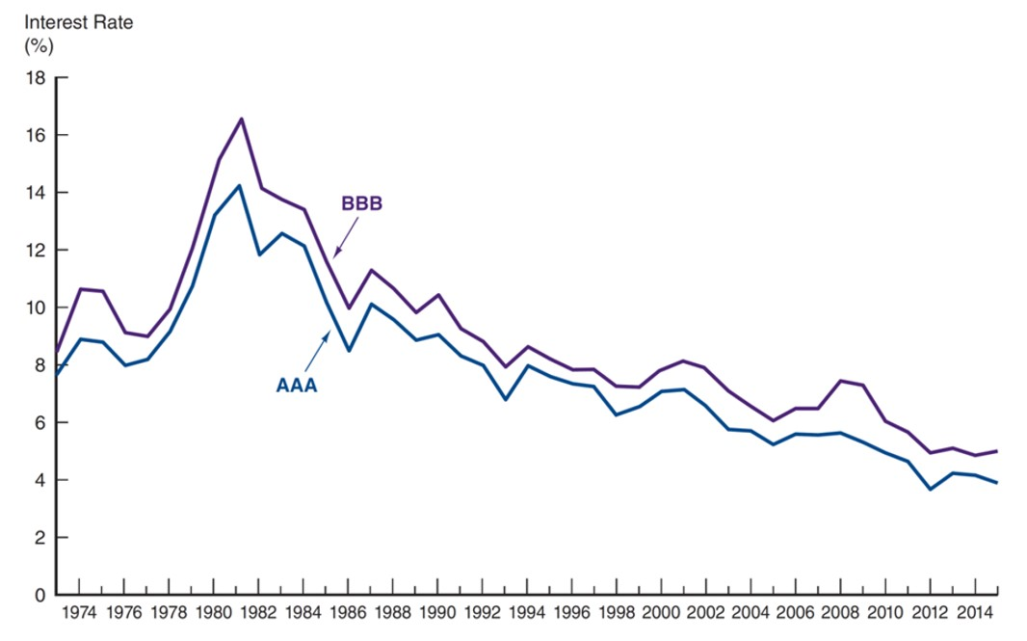
Corporate Bond Interest Rates, 1973–2015 (End of Year)
Source:
http://www.federalreserve.gov/releases/h15/data.htm
.
Notes:
The vertical axis is labeled Interest rate left parenthesis percent right parenthesis and ranges from 0 to 18 in increments of 2. The horizontal axis lists dates from 19 74 to 20 14 in 2-year increments. The line for A A A shows interest rate for the year 19 74 as 8.5%, which increases to a peak value of 14% by the year 19 81. The interest rate for this category shows a consistent decline over the year and falls down to a value of 8% by the year 19 86, 7% by year 19 93, 6% by 2003, and to 4% by 2012. The line for B B B shows interest rate for the year 19 76 as 10%, which increases to a peak value of 17% by the year 19 81. The interest rate for this category shows a consistent decline over the year and falls down to a value of 10% by the year 19 86, 9% by year 19 93, 7% by 2003, and to 6% by 20 12.

Slide 21
Characteristics of Corporate Bonds
Registered Bonds
Replaced “bearer” bonds
I R S can track interest income this way
Restrictive Covenants
Mitigates conflicts with shareholder interests
May limit dividends, new debt, ratios, etc.
Interest rate is lower the more restrictions are placed on management through covenants

Slide 22
Characteristics of Corporate Bonds
Call Provisions
Higher required yield
Mechanism to adhere to a sinking fund provision
Interest of the stockholders
Altering capital structure
Conversion
Some debt may be converted to equity
This feature permits bondholders to share in the firm’s good fortunes if the stock price rises.
The conversion ratio will be such that the price of the stock must rise substantially before conversion is likely to occur.

Slide 23
Characteristics of Corporate Bonds
Secured Bonds
Bonds with collateral attached
Mortgage bonds: are used to finance a specific project. For example, a building may be the collateral for bonds issued for its construction.
Equipment trust certificates: Bonds secured by tangible non-real-estate property, such as heavy equipment and airplanes.

Slide 24
Characteristics of Corporate Bonds
Unsecured Bonds
Debentures: Long-term unsecured bonds that are backed only by the general creditworthiness of the issuer. No specific collateral is pledged to repay the debt.
Subordinated debentures: Similar to debentures except that they have a lower priority claim.
Variable-rate bonds

Slide 25
Characteristics of Corporate Bonds
Junk Bonds
Debt that is rated below B B B
Often, trusts and insurance companies are not permitted to invest in junk debt
Poor liquidity
A very real chance existed that the issuing firms would default on their bond payments.

Slide 26
Financial Guarantees for Bonds
Some debt issuers purchase financial guarantees to lower the risk of their debt.
The guarantee provides for timely payment of interest and principal and are usually backed by large insurance companies.
In 1995, J P Morgan created the credit default swap (CDS), a type of insurance on bonds.

Slide 27
Oversight of the Bond Markets
Bond trades are not available to the public, making trading less transparent. bonds typically trade over the counter
Trade reporting and compliance engine (T R A C E), under F I N R A, was developed to:
Make some bond transactions reported to the public
Develop a trading platform to make transaction data available to the public

Slide 28
Finding the Value of Coupon Bonds
Bond pricing is, in theory, no different than pricing any set of known cash flows.
Once the cash flows have been identified, they should be discounted to time zero at an appropriate discount rate.

Slide 29
Bond Terminology
Term | Definition
Coupon interest rate | The stated annual interest rate on the bond. It is usually fixed for the life of the bond.
Current yield | The coupon interest payment divided by the current market price of the bond.
Face amount | The maturity value of the bond. The holder of the bond will receive the face amount from the issuer when the bond matures. Face amount is synonymous with par value.

Slide 30
Bond Terminology
Term | Definition
Indenture | The contract that accompanies a bond and specifies the terms of the loan agreement. It includes management restrictions, called covenants.
Market rate | The interest rate currently in effect in the market for securities of similar risk and maturity. The market rate is used to value bonds.

Slide 31
Bond Terminology
Term | Definition
Maturity | The number of years or periods until the bond matures and the holder is paid the face amount.
Par value | The same as face amount, the maturity value of the bond.
Yield to maturity | The yield an investor will earn if the bond is purchased at the current market price and held until maturity.

Slide 32
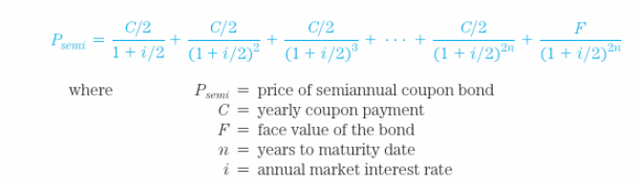
Finding the Value of Coupon Bonds
Let’s use a simple example to illustrate the bond pricing idea.
What is the price of two-year, 10% coupon bond (semi-annual coupon payments) with a face value of $1,000 and a required rate of 12%?

Slide 33
Finding the Value of Coupon Bonds
Solution:
Identify the cash flows:
$50 is received every six months in interest
$1000 is received in two years as principal repayment
Find the present value of the cash flows (calculator solution):
N = 4, F V = 1000, P M T = 50, I = 6
Computer the P V. P V = 965.35

Slide 34
Current Yield Calculations
The current yield is an approximation of the yield to maturity on coupon bonds that is often reported because it is easily calculated.
It is defined as the yearly coupon payment divided by the price of the security.

Slide 35


Bond Current Yield Calculation
What is the current yield for a bond with a face value of $1,000, a current price of $921.01, and a coupon rate of 10.95%?
Answer:
$$i_{c}=C/P=\$109.50/\$921.01=11.89\%$$
Note: C (coupon)
$$=10.95\%×\$1,000$$
$$=\$109.50$$

Slide 36
Investing in Bonds
Bonds are lower risk than stocks because they have a higher priority of payment.
Bonds are the most popular alternative to stocks for long-term investing.
They offer relative security and dependable cash payments, making them ideal for retired investors and those who want to live off their investments.
Even though the bonds of a corporation are less risky than its equity, investors still have risk. Bond investors face fluctuations in price due to market interest-rate movements in the economy.
The possibility of suffering a loss because of interest-rate changes is called interest-rate risk.

Slide 37
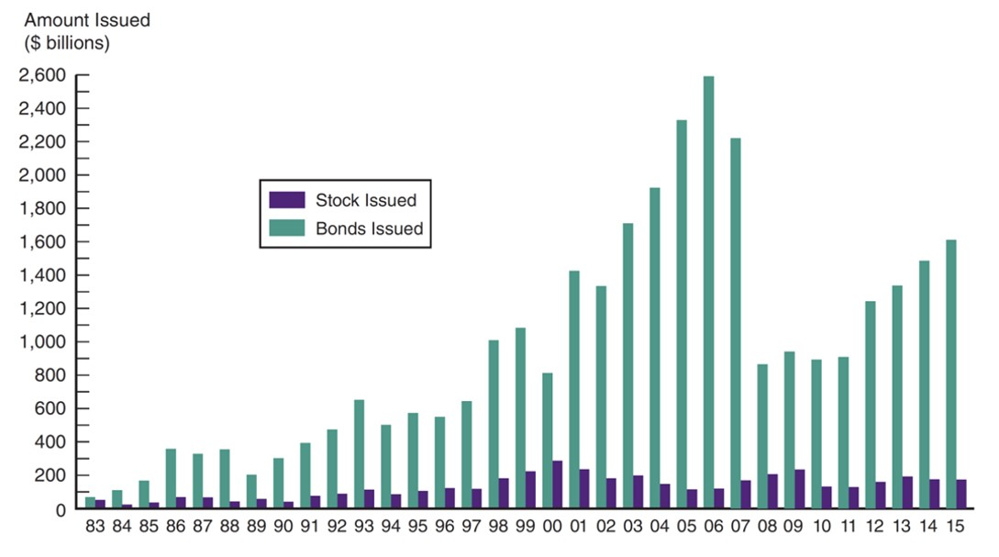
Bonds and Stocks Issued, 1983–2015
Source:
http://www.federalreserve.gov/econresdata/releases/corpsecure/current.htm
.
Notes:
The vertical axis is labeled Amount Issued left parenthesis dollar billions right parenthesis and ranges from 0 to 2,600 in increments of 200. The horizontal axis lists dates from 19 83 to 20 15. The data from the graph is as follows. All values are approximate. Year Amount Issued left parenthesis dollar billions right parenthesis Bonds Issued Stock Issued 19 83 80 70 19 84 125 25 19 85 175 50 19 86 300 100 19 87 250 75 19 88 300 50 19 89 200 60 19 90 300 40 19 91 400 75 19 92 450 100 19 93 650 110 19 94 450 100 19 95 500 110 19 96 480 110 19 97 625 110 19 98 1000 175 19 99 1100 225 2000 800 260 2001 1400 225 2002 1300 200 2003 1700 210 2004 1900 180 2005 2300 150 2006 2500 150 2007 2200 175 2008 850 200 2009 950 220 20 10 925 130 20 11 940 130 20 12 1350 160 20 13 1400 200 20 14 1550 220 20 15 1650 220

Slide 38
Chapter Summary (1 of 4)
Purpose of the Capital Market: provide financing for long-term capital assets
Capital Market Participants: governments and corporations issue bond, and we buy them
Capital Market Trading: primary and secondary markets exist for most securities of governments and corporations

Slide 39
Chapter Summary (2 of 4)
Types of Bonds: includes Treasury, municipal, and corporate bonds
Treasury Notes and Bonds: issued and backed by the full faith and credit of the U.S. Federal government
Municipal Bonds: issued by state and local governments, tax-exempt, defaultable.

Slide 40
Chapter Summary (3 of 4)
Corporate Bonds: issued by corporations and have a wide range of features and risk
Financial Guarantees for Bonds: bond “insurance” should the issuer default
Oversight of the Bond Markets: T R A C E developed to add transparency to bond markets

Slide 41
Chapter Summary (4 of 4)
Finding the Value of Coupon Bonds: determining the cash flows and discounting back to the present at an appropriate discount rate
Bond Current Yield Calculation: how to calculate the current yield for a bond
Investing in Bonds: most popular alternative to investing in the stock market for long-term investments

Slide 42
Financial Markets and Institutions
Ninth Edition, Global Edition
Reading – Chapter 12 The Bond Market
Notes:
If this PowerPoint presentation contains mathematical equations, you may need to check that your computer has the following installed:
1) MathType Plugin
2) Math Player (free versions available)
3) NVDA Reader (free versions available)

